Slide 1
Marketing Analytics
Analysis of a general retail store
Group - 5
Name | Roll No.
Pradeep M S | 2011031
Bhuvaneshwaran S | 2011057
Dharanie Shankar R | 2011201
Rahul B Venu | 2011290
Balaji CT | 2011378
R Naveen Raj | 2011496
Rahav Manoharan | 2017026

Slide 2
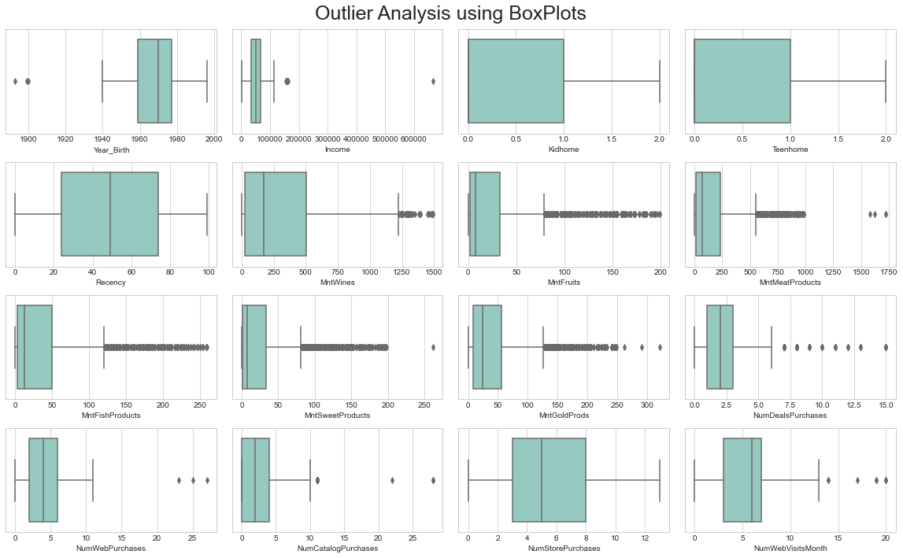
Outlier-Detection using boxplots

Slide 3
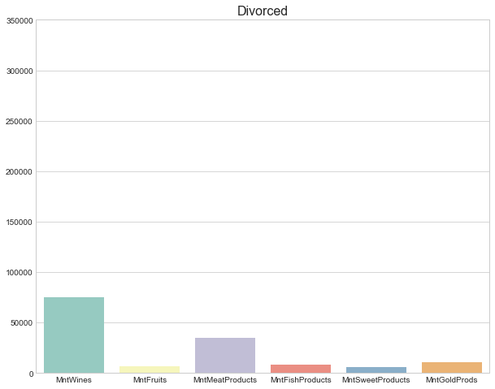
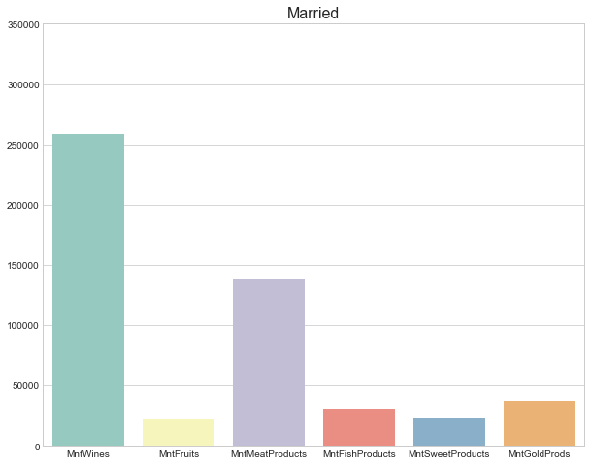
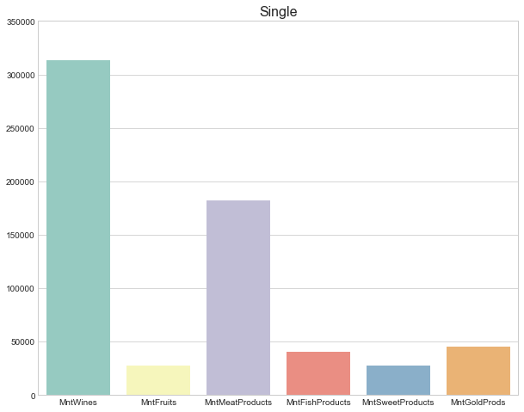
Martial status and Purchase behavior
Divorced people had purchased around 70,000+ wines, whereas single people had purchased 300,000+ wines in the past year alone, which is 4.3x times the divorced
#Single: 480
#Divorced: 232
Divorced customers had purchased around 3000+ Meat products, whereas Single customers had purchased around 170,000+ meat products which is 56x times the divorced
#Married: 684

Slide 4
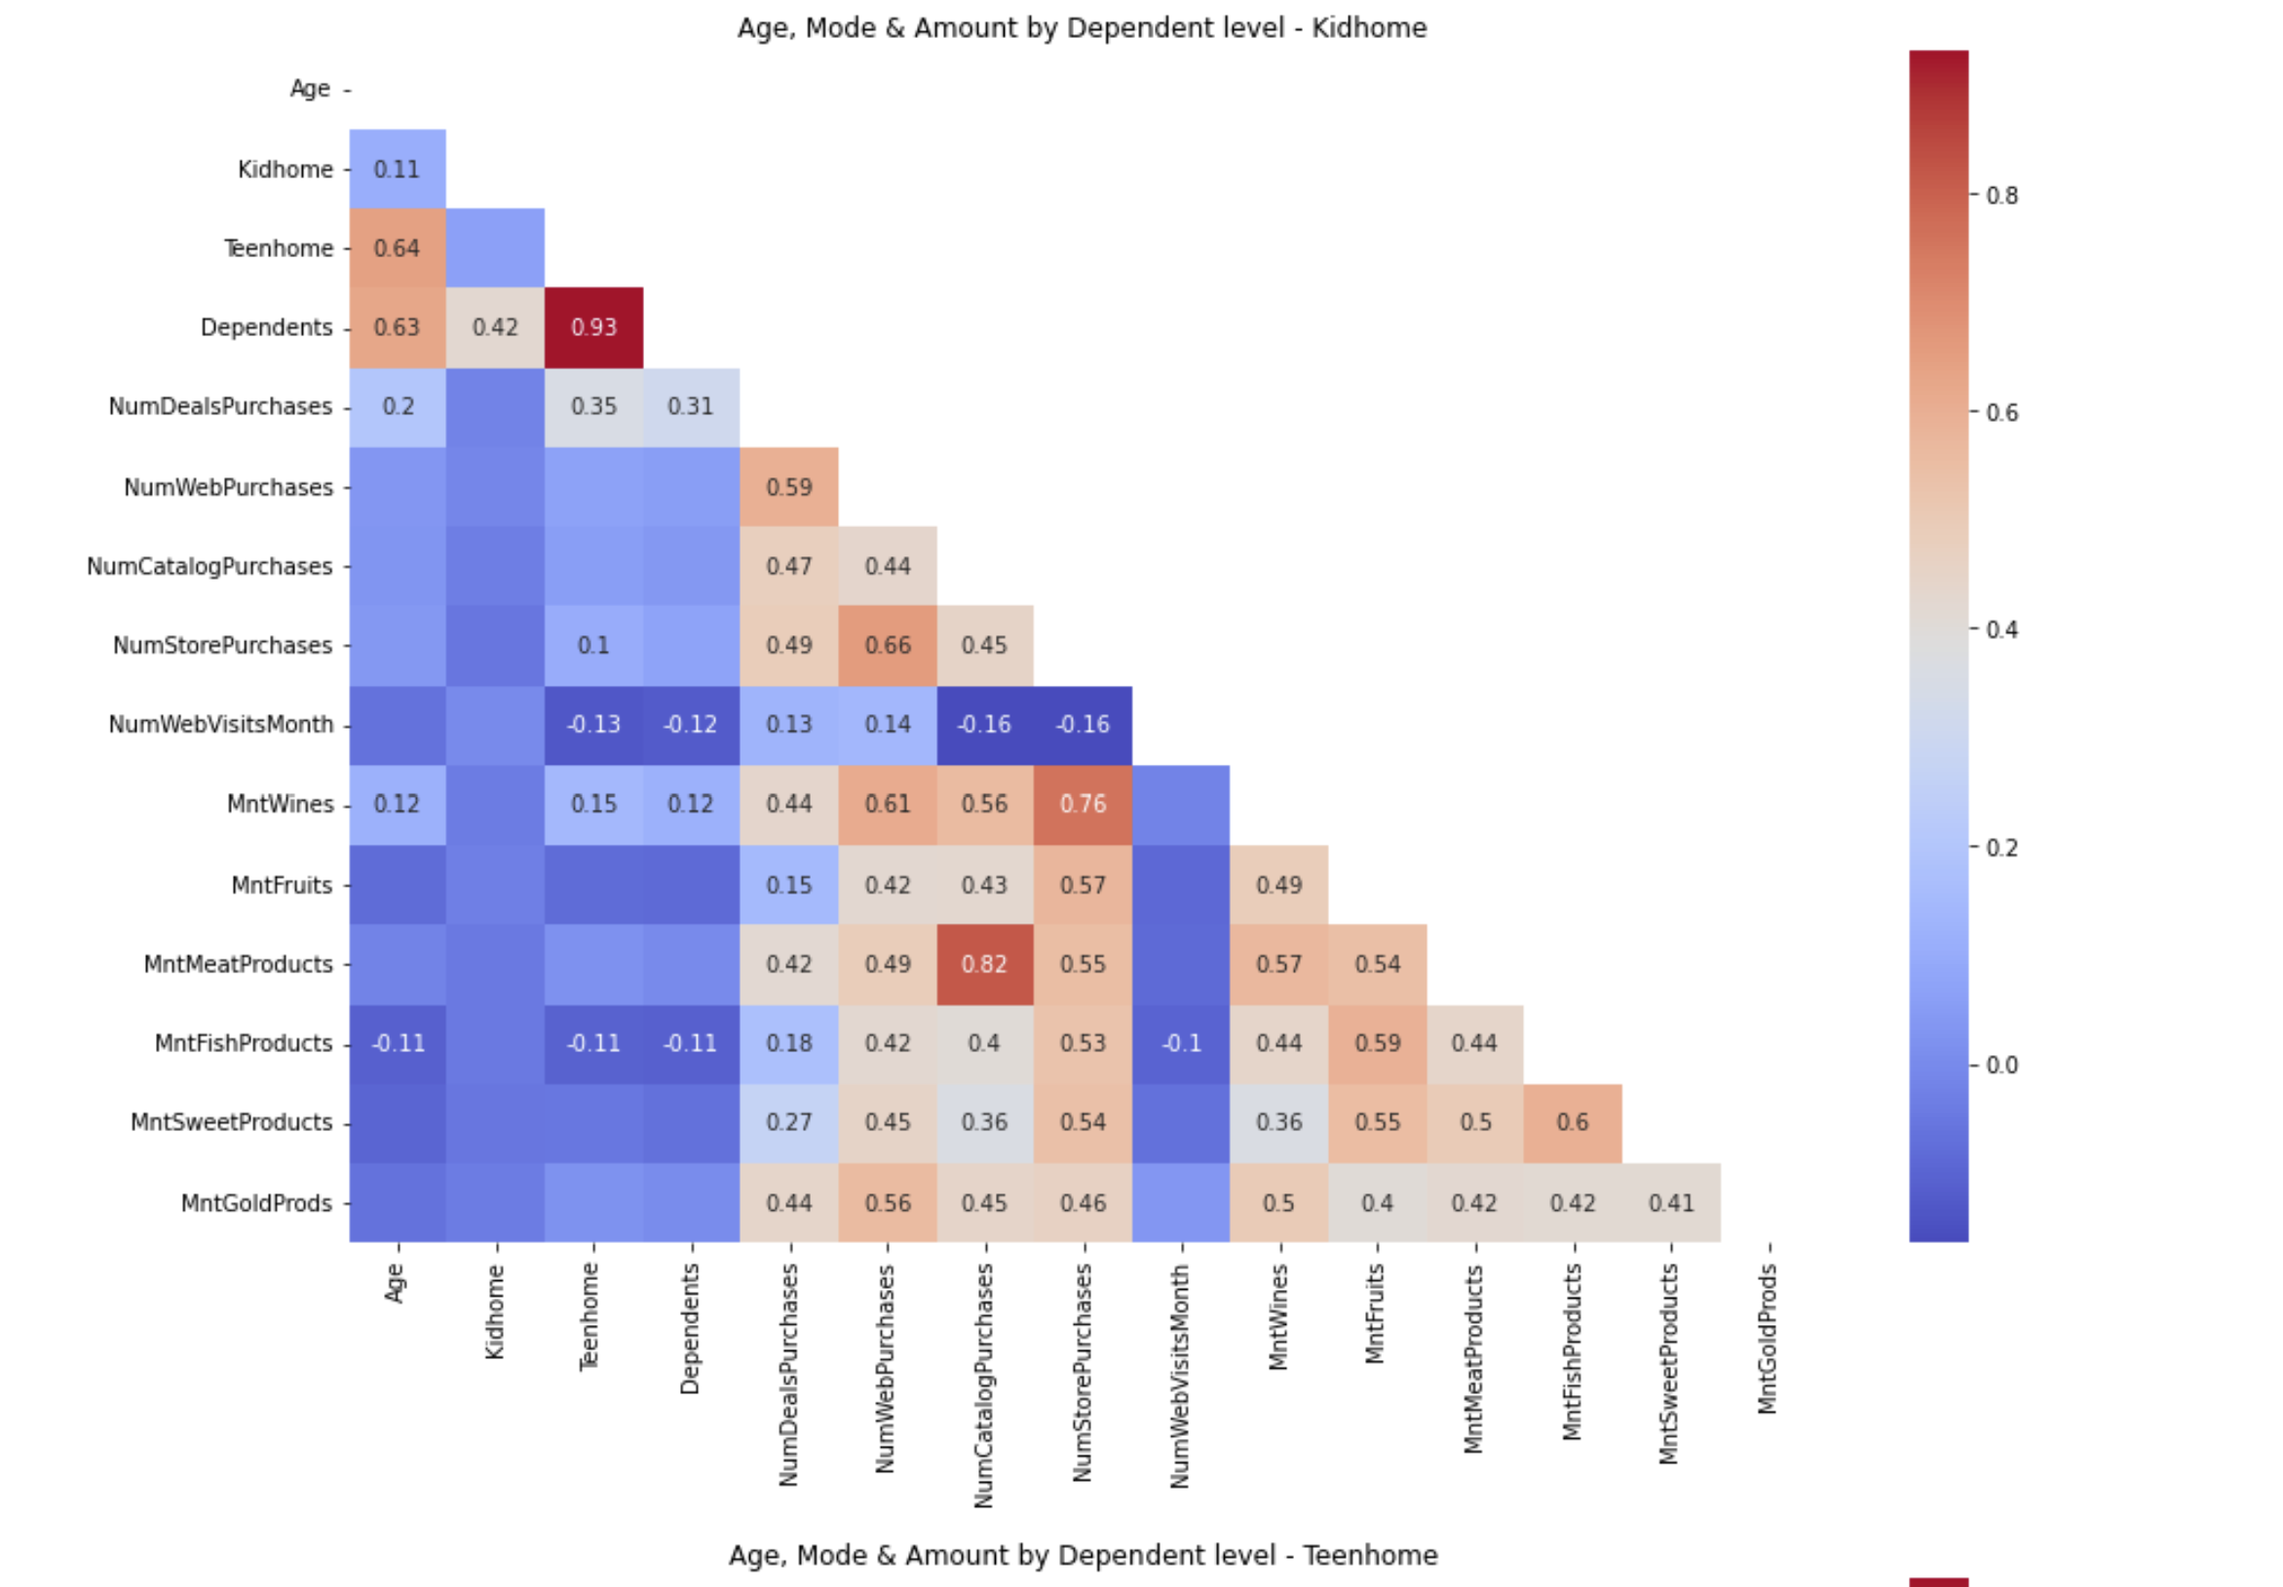
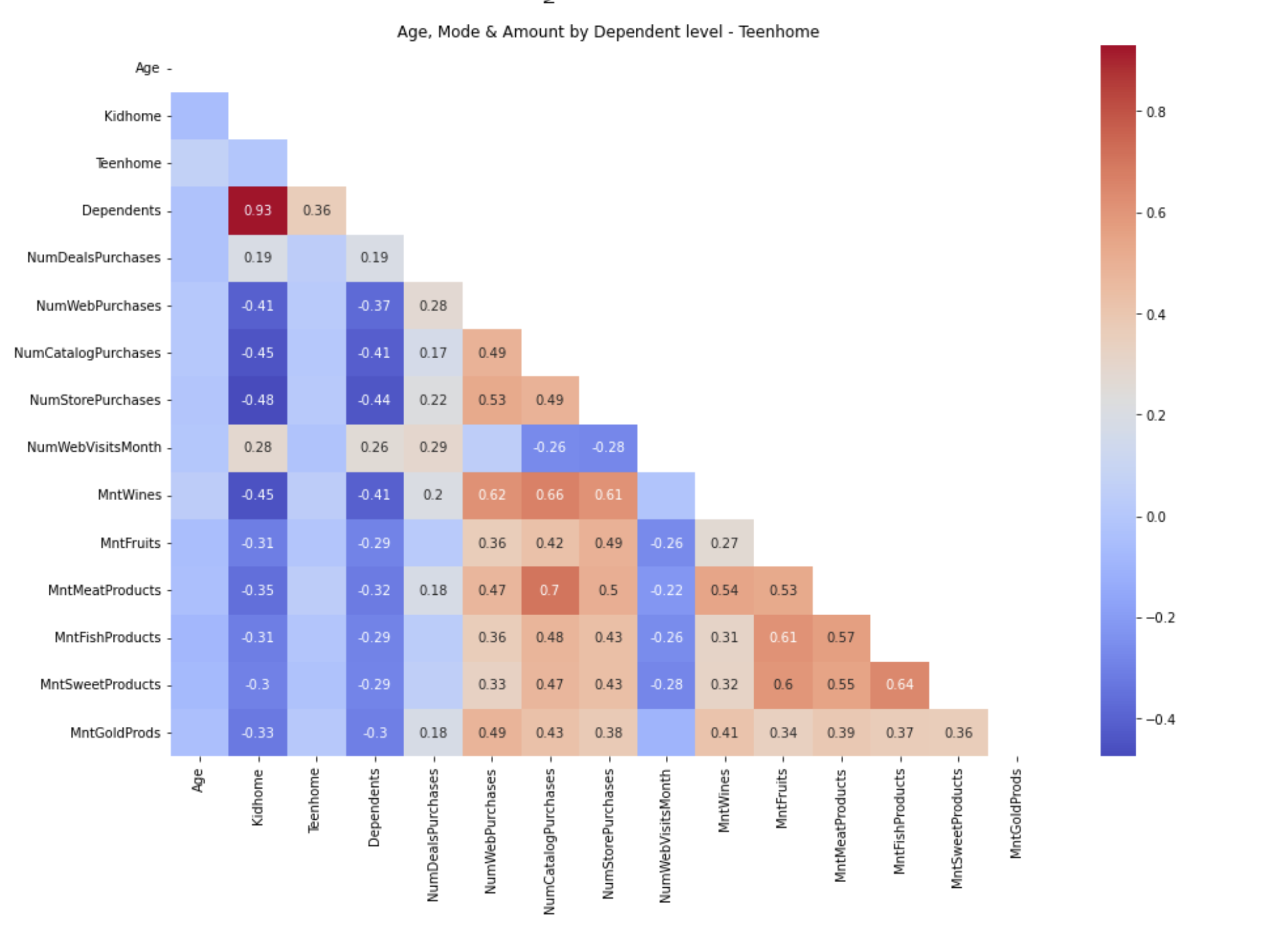
Kids & Teens and Purchase Behaviour (1/2)
In this case we could not find any significant correlation either between various products or with the mode of purchase. There is a significant correlation between the variables kids at home and dependents but this too doesn’t provide any valuable insight.
In this case too we couldn’t find any significant correlation either between various products or with the mode of purchase. Yet again We got positive correlation only between teens at home and dependents which is not insightful.

Slide 5
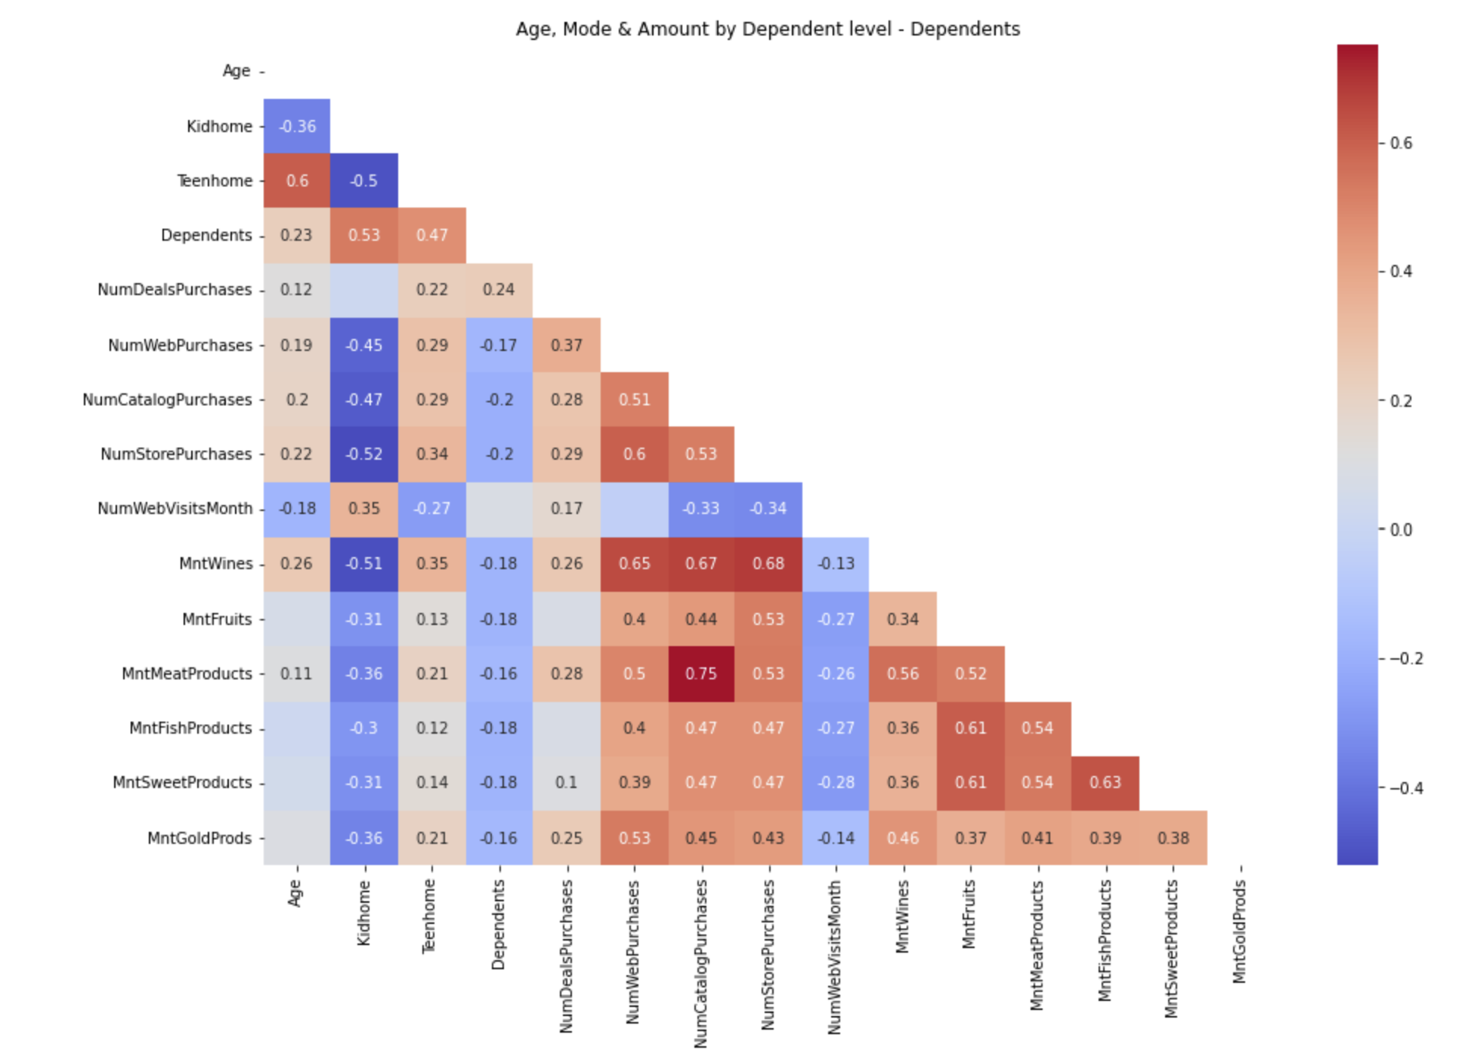
Kids & Teens and Purchase Behaviour
Possible attribution:
If a family has dependents (both kids and teens), assuming the family has a toddler of age between 1 and 4, and since the parents would be looking after the toddler, the teens at home are sent for purchase. The purchase happens both via store and web, but it happens through the teen. Also, since the deals purchased is also positively correlated, we can conclude that since a family has both kids and teens, they would look for deals to avail discounts.
The marketing campaigns can target families having 2 or more kids with them having a teen. Since the deals are also working better with this target the communication of the campaigns can highlight this.
Even though kids at home and dependents both had negative correlation with other variables, teens at home on contrast has a significant positive correlation with a lot of variables. This suggests that teenagers have some positive influence on the purchases.

Slide 6
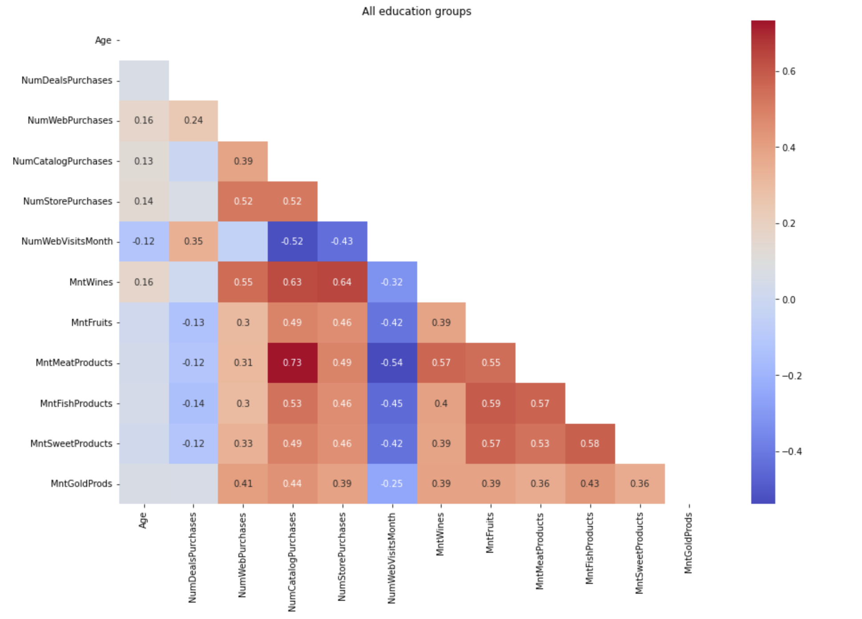
Age as a factor
Number of web visits per month is negatively correlated with Age – higher the age, lower the number of web visits, which is very much pronounced in the case of people with Basic Education (-0.28), implying that they’re not convenient with online purchases and prefer store purchase. Though the number of web visits is negatively correlated, web purchases are positively correlated, implying that young people do lot of online window shopping compared to the number of web visits they do. So, the conversion factor (purchases done when they visit the website) is higher for older people.

Slide 7
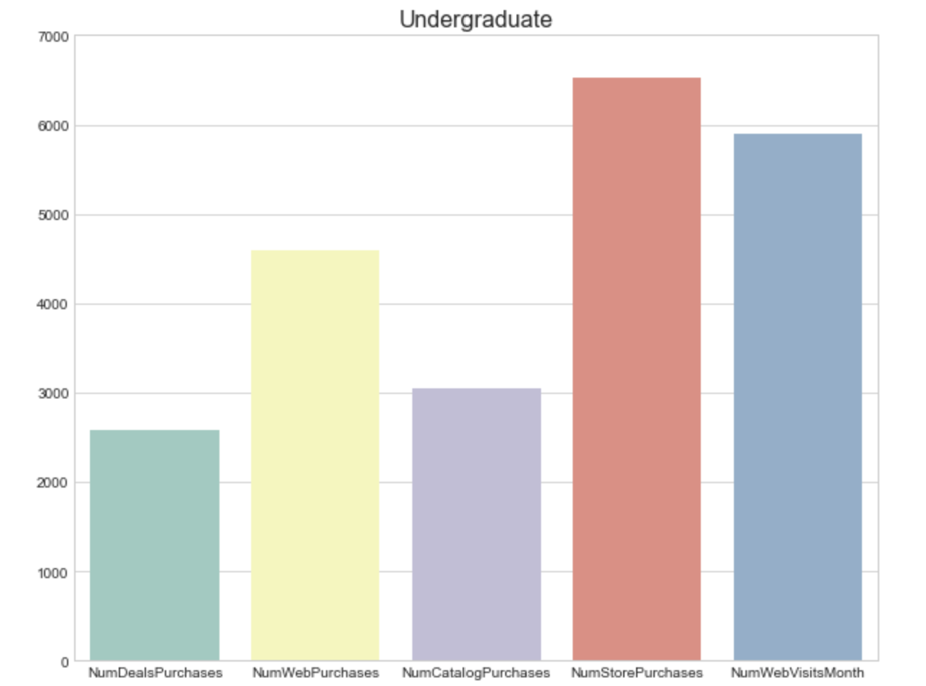
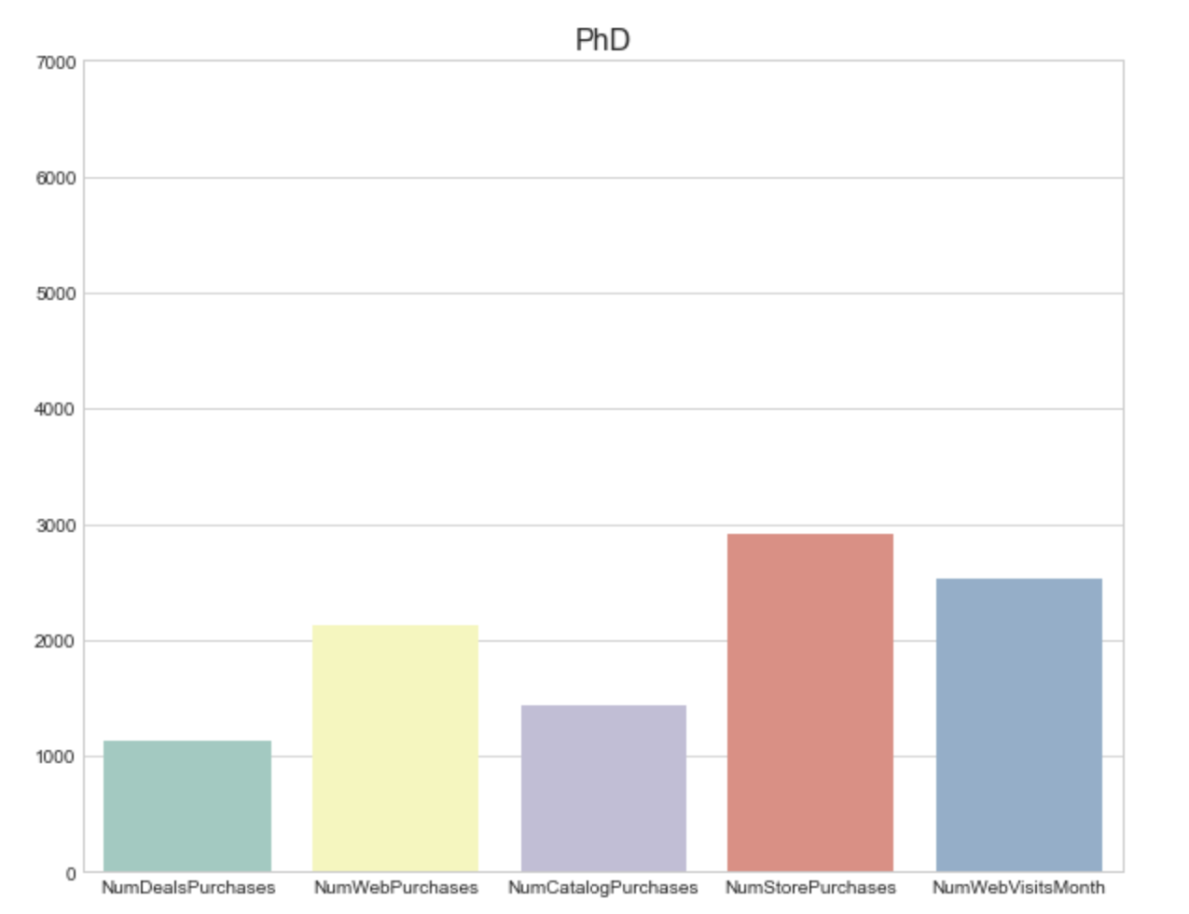
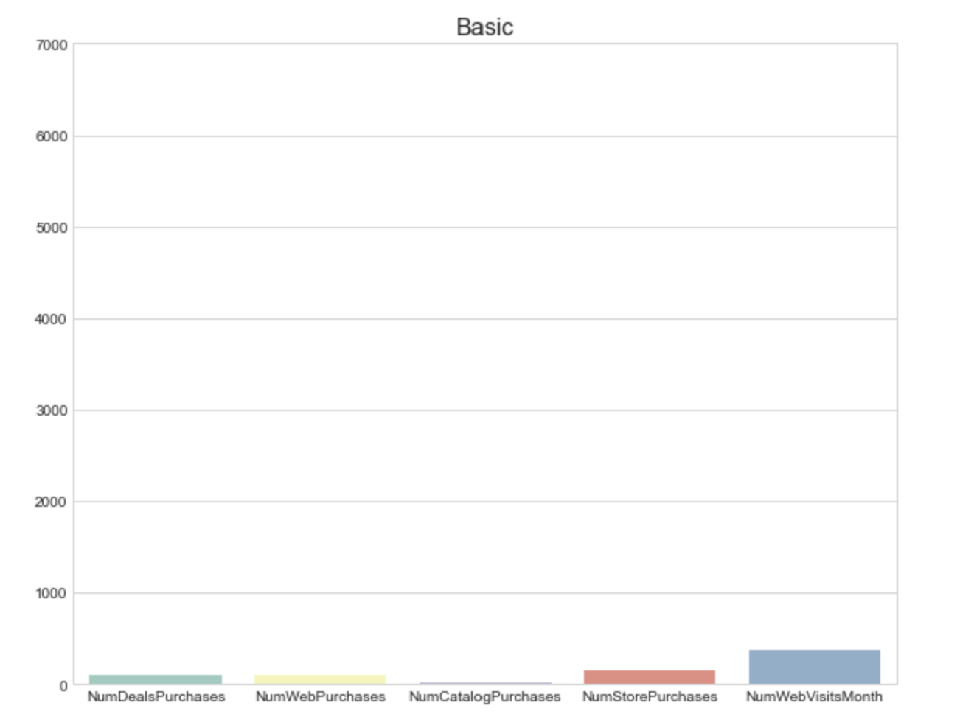
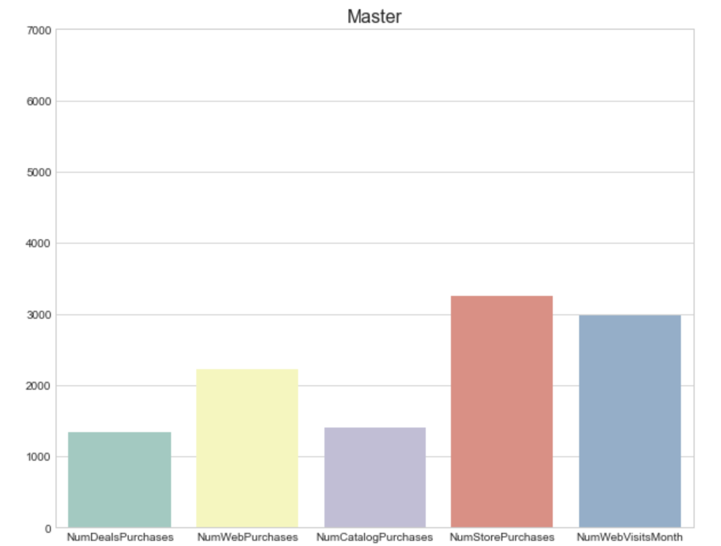
Education
The purchase behavior of both segment looks similar across different channels and products. However, UG segment relatively have made more purchases when compared to PhD segment. The difference between Webs visits and store purchase for both segments is very less, which suggests that people in both segments do research online before purchasing.

Slide 8
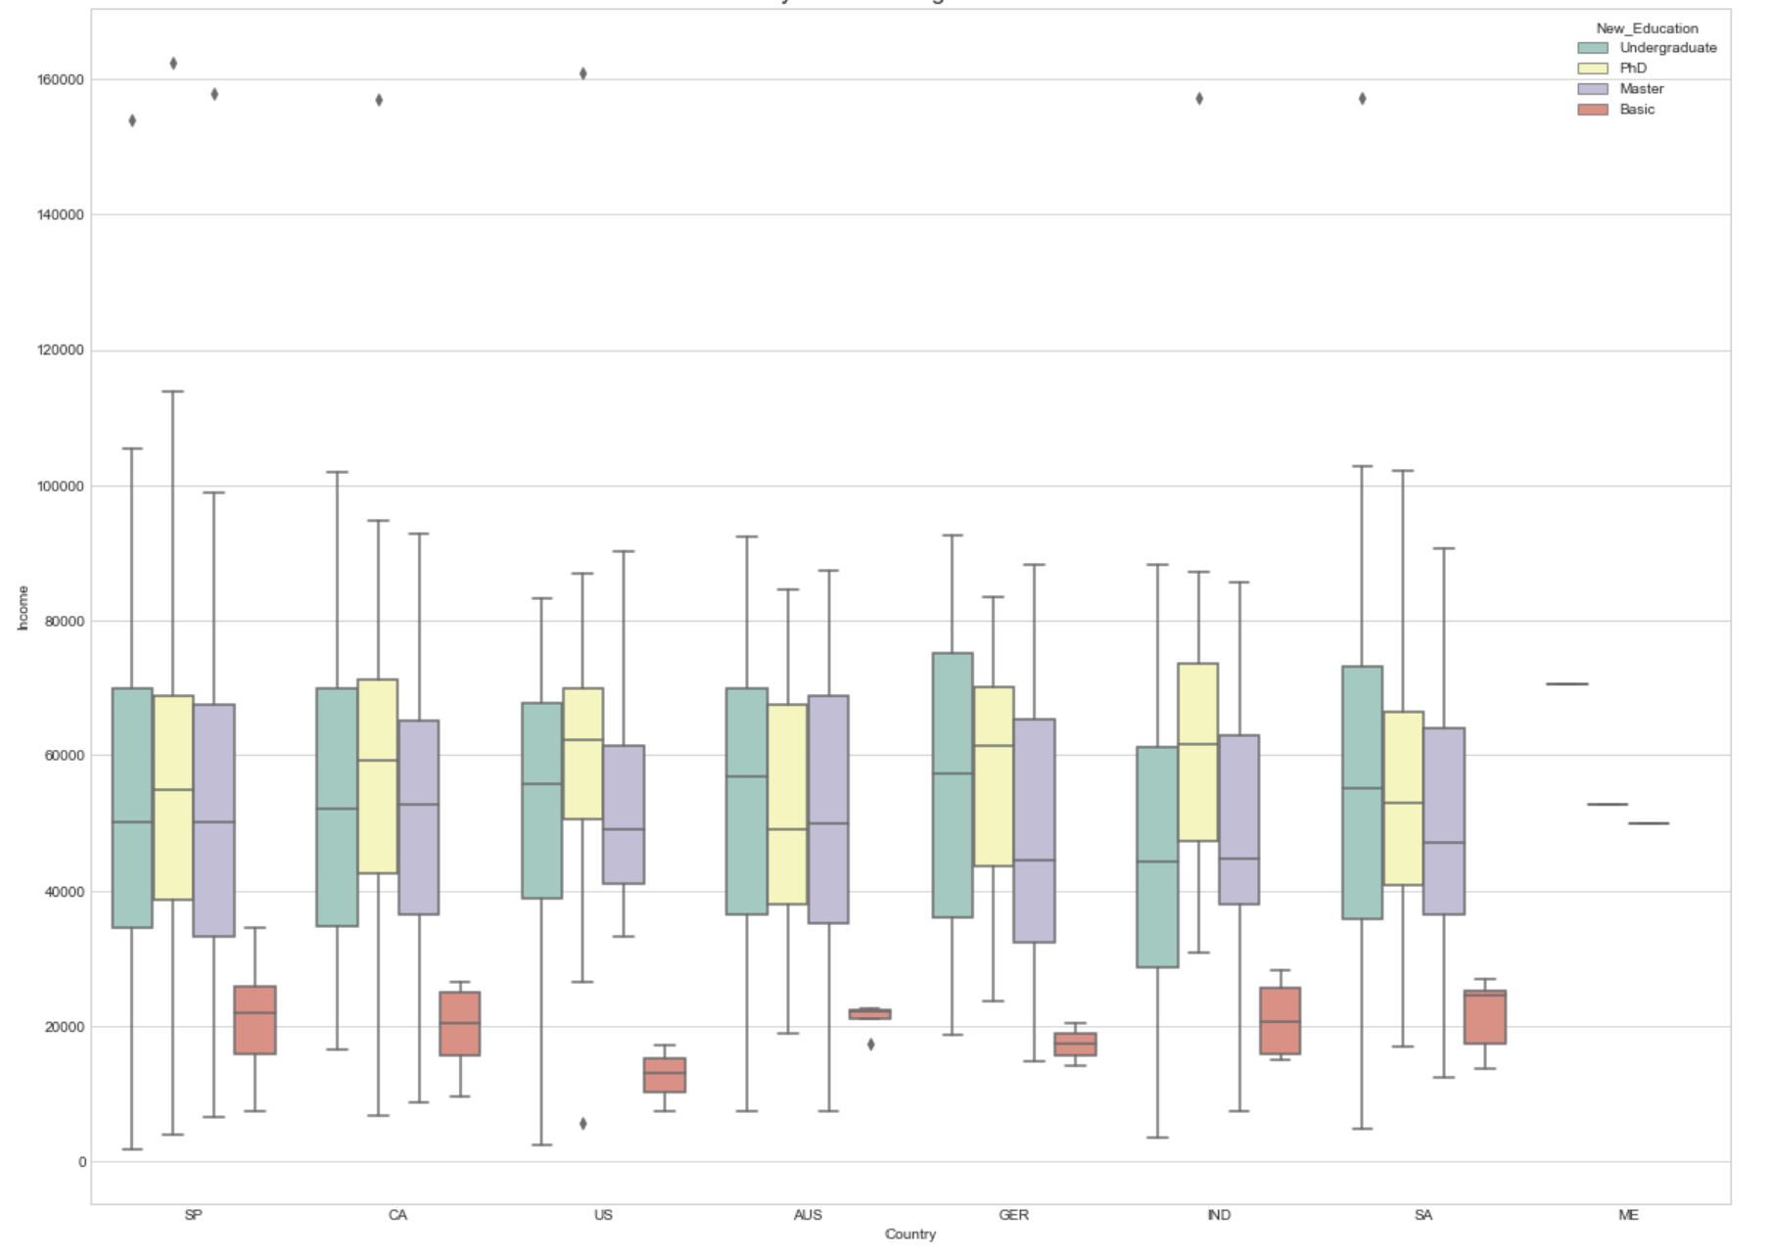
Income as a factor
Purchases increase with household income.
Website visits have high conversion rates as income increases. It can be understood that, more the household income, the less time spent pondering over the purchase.
Campaigns have an influence on the purchase behavior of certain income groups and can be means of targeting.
Catalog purchases are positively (0.70) correlated with income, indicating preference over website, store and deals as the go to means of purchase for higher income segments
No. of website visits / month is negatively (-0.65) correlated with income. Web purchases on the other hand is positively correlated with income at 0.46
Campaign 5 is positively correlated with income, and campaigns 1 and 5 are correlated with each other – hence, it can be understood that campaigns 1 and 5 are targeted for similar income range, i.e., high income households

Slide 9
RFM Analysis …to the rescue

Slide 10
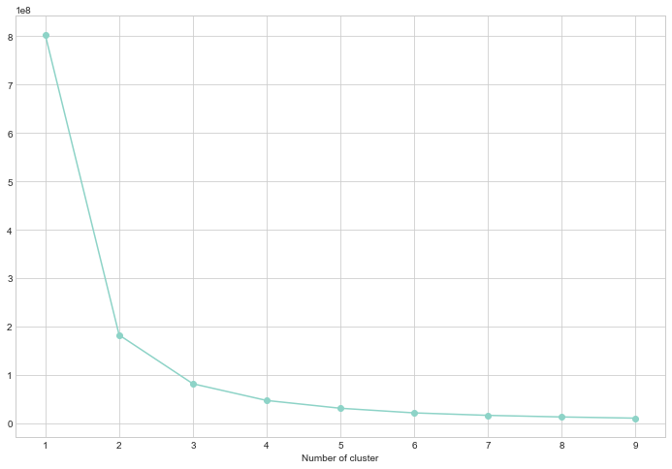
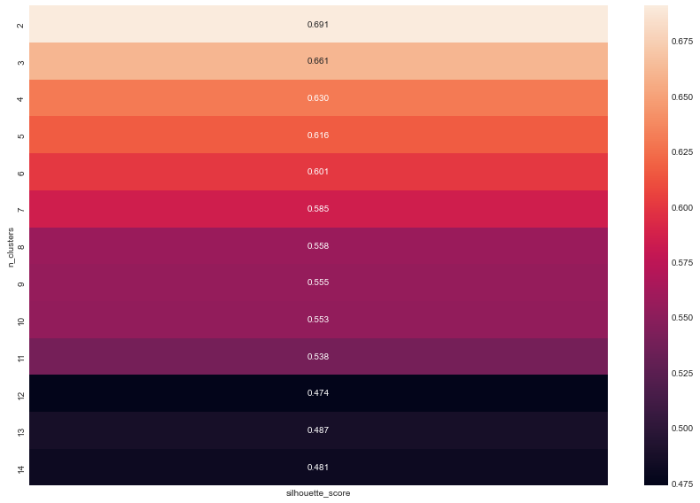
Clustering & RFM analysis (1/2)
Inertia (Elbow method):
Silhouette Scores:

Slide 11
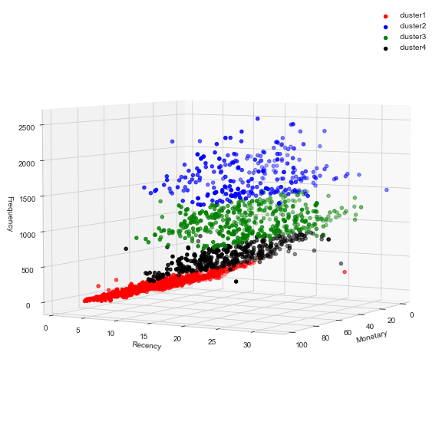
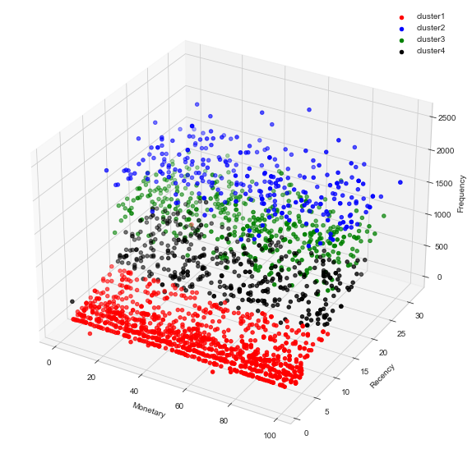
Clustering & RFM analysis (2/2)
Bought & Left Indecision Regulars Potentially lost

Slide 12
Thank you

